Slide 1
Applications of Finite Automata (FA) a.k.a. Finite State Machines (FSM) and RE

Slide 2
Text Processing
Identifying tokens (keywords, identifiers, constants) and verifying if they follow their specified format of a certain programming language. E.g.
RE for character constants/literals: ‘α’ where α is any character in ASCII table
RE for decimal integer constants in C: (1/2/…/9)(0/1/…/9)*
RE for octal integer constants in C: 0(0/1/…/9)⁺
RE for hexadecimal integer constants in C: 0(x/X) β⁺ where β = 0/1/…/9/a/b/…/f/A/B/…/F
RE for floating point constants: ?
Identifier name rules in C: an identifier (variable/struct/function) name must start with letter/underscore, afterwards any combination of letter, underscore and digit may follow.
Unix tools like grep, sed, awk, etc. rely on the concepts of FA and RE for pattern-matching
Query languages (such as SQL) also rely on these concepts
RE for identifier names in C: (α / _) (α / β /_)*
where α = a/b/…/z/A/B/…/Z and β = 0/1/…/9

Slide 3
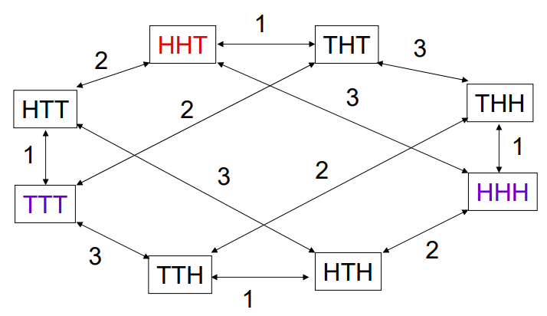
Puzzle Solving
Some puzzles can be modeled and solved via FA/FSM for e.g. 3-coins problem
Given 3 coins and 3 legal moves/operations (1: flip coin-1, 2: flip coin-2, 3: flip coin-3) you need to ensure that all coins show the same face (Head/Tail) using minimum number of moves from any initial state. How many moves will you need to ensure that?
State Space Graph for 3-coins Problem

Slide 4
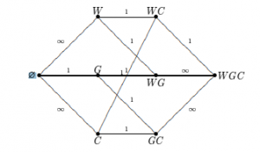
Puzzle Solving (contd.)
Wolf, goat, cabbage riddle: A farmer went to a market and purchased a wolf, a goat, and a cabbage. On his way home, the farmer came to the bank of a river and rented a boat. But the boat was too small and as such the farmer could carry only himself and a single one of his purchases: the wolf, the goat, or the cabbage. If left unattended together, the wolf would eat the goat, or the goat would eat the cabbage. The farmer's challenge was to carry himself and his purchases to the far bank of the river, leaving each purchase intact.
What is the minimum number of steps (river crossings) to solve this problem?
What are the sequences of steps needed to solve this problem?
Are there any alt. seq. of steps to solve this problem?
Solution: https://www.geeksforgeeks.org/puzzle-farmer-goat-wolf-cabbage/
State Space Graph for this Problem

Slide 5
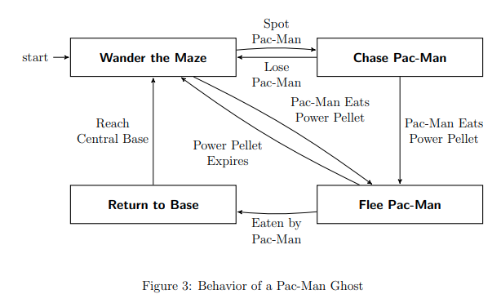
Video Game Design
E.g. Pacman
Courtesy: https://www.cs.ucdavis.edu/~rogaway/classes/120/spring13/eric-dfa.pdf

Slide 6
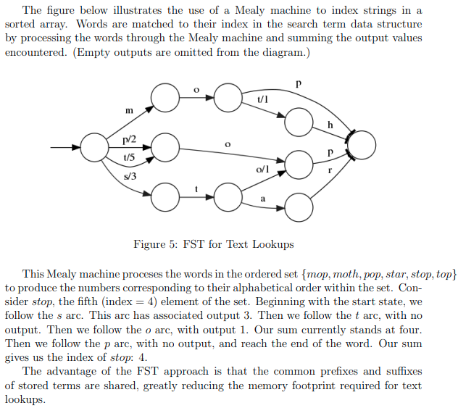
Indexing in a Database
of Strings
Task: create a FSM-based index for
the following ordered set of words:
[poem, poet, poetry, pop, pope, pot, top, toss]
Courtesy: https://www.cs.ucdavis.edu/~rogaway/classes/120/spring13/eric-dfa.pdf

Slide 7
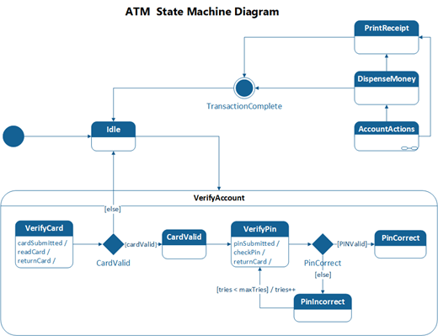
In Software Engineering
State Diagram (a type of UML diagram that describes the behavior of a software/other type of system) is a variation of FSM.
Courtesy: https://support.microsoft.com/en-us/office/create-a-uml-state-machine-diagram-8a681a4d-cf9d-4f57-af07-e91323606366

Slide 8
In Software Engineering (contd.)
Automata can be used for software verification: The role of automata theory in software verification
Sometimes Automata based programming is more convenient especially if the number of states is few. In such cases, we can simply translate our automata to equivalent code (e.g. via some tool) instead of manual coding.
There is a Software design pattern called State Pattern which is used for objects whose behavior changes when its internal state changes. The State Pattern is based on automata theory.

Slide 9
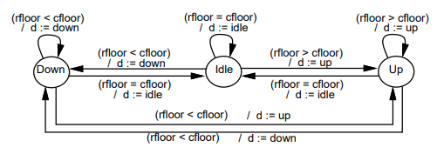
Sequential Logic Circuit Design
We shall only show examples of Mealy machines (a type of DFA which not only makes state-transition upon an input but also may take an action while state-transition; you already have learned it in CSE231)
In a Mealy machine each transition is labeled by: “input/action”
Some applications of Mealy machines in real life:
Traffic Light Controller
Vending Machine Controller
Door Controller
Elevator Controller
And so on.
Courtesy: https://www.researchgate.net/publication/2354061_HardwareSoftware_Co-Design_Principles_and_Practice

Slide 10
Modeling, Verification, and Analysis of Systems
Industrial automation and supply chain networks can be modeled and analyzed by FSM [1, 2]
Some type of automata are used for verifying the correctness of finite state models representing any system (software/hardware/biological/other)
Some relevant papers:
An Automata-based Framework for Verification and Bug Hunting in Quantum Circuits (2023)
Reconstructing signaling pathways using regular language constrained paths (An approach to find signaling pathways using the concepts of RE and product DFA) (2019)
Verification of the Generic Architecture of a Memory Circuit Using Parametric Timed Automata (2006)

